Slide 1
Design and Analysis of Algorithm
Instructor: Muhammad Arif shah

Slide 2
Asymptotic Notation
Given any function g(n), we define Θ(g(n)) to be a set of functions that asymptotically equivalent to g(n).
Formally,
This can be written as

Slide 3
Example
Lower Bound:
f(n) grows asymptotically at least as fast as n²
For this, we need to show that there exist positive constants c₁ and n₀, such that for all
Consider the reasoning
We implicitly assumed that 2n ≥ 0 and n²-3 ≥ 0
These are not true for all n but if then both are true
for we have for all

Slide 4
Example
Upper Bound: f(n) grows asymptotically no faster than n²
we need to show that there exist positive constants c₂ and n₀, such that for all
Consider the reasoning
Thus c₂ = 10
We implicitly made the assumption that

Slide 5
Example
This is not true for all n but it is true for all n ≥ 1
So select n₀ ≥ 1
We thus have

Slide 6
Final answer
From Lower Bound we have
From Upper Bound we have
Combining the two, we let n₀ be the larger of the two:
In conclusion, if we let c₁ = 7, c₂ = 10 and then we have
thus

Slide 7
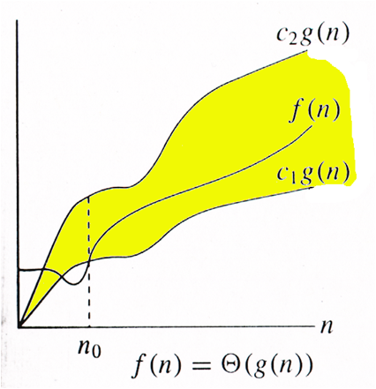
Graphically

Slide 8
We have established that
This selection may be right or may be wrong
We have to prove or disprove any given f(n) and g(n) whether they are correctly chosen.
We have to prove that our choice of g(n) is correct
Let’s show why f(n) is not in some other asymptotic class

Slide 9
Why not ϴ (n)
First let’s show that
If this were true, we would have had to satisfy both the upper and lower bounds.
The lower bound is satisfied because does grow at least as fast asymptotically as n
But the upper bound is false. It requires that there exist positive constants c₂ and n₀ such that f(n)≤ c₂n for all n ≥ n₀
Informally, we know that will eventually exceed c₂n, no matter how large we make c₂

Slide 10
Why not Θ(n)
To see this, suppose we assume that constants c₂ and n₀ did exist such that 8n2+2n-3≤c₂n for all n≥n₀
Since this is true for all sufficiently large n then it must be true in the limit as n tends to infinity
If we divide both sides by n, we have
It is clear that left side tends to ∞
So no matter how large c₂ is, the statement is violated. Thus

Slide 11
Another Example
Let’s show that
The idea would be to show that the Lower Bound f(n)≥c₁n³ for all n≥n₀ is violated
We know that c₁ and n₀ are positive constants
Informally, we know this to be true because any cubic function will overtake a quadratic.
Dividing both sides by n³,we have
The left side tends to 0. The only way to satisfy this is to set c₁ = 0. However, c₁ must be positive.
This means that

Slide 12
O- and Ω-notations
The definition of Θ-notation relies on proving both a Lower and Upper asymptotic bounds.
Sometimes, we are only interested in proving one bound or the other.
The O-notation is used to state only the asymptotic Upper Bound
The Ω-notation allows us to state only the asymptotic Lower Bound

Slide 13
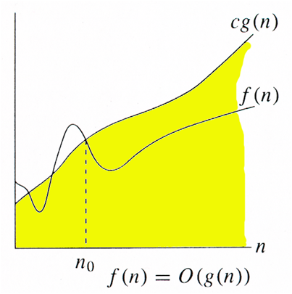
Big-O notation

Slide 14
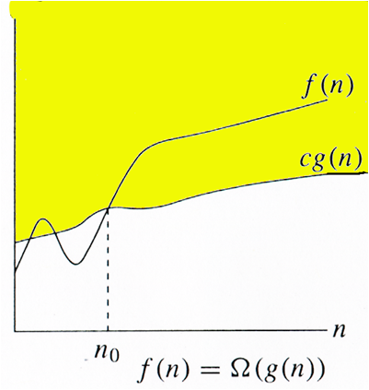
Big-Omega notation

Slide 15
Θ-, O- and Ω-notations
For comparison purpose, Big-O, Big-theta,
and Big-Omega notations are easier and
effective

Slide 16
Asymptotic Intuitions
Θ(1): Constant time; cannot beat it
Θ(log n): Inserting into a balanced binary tree; time to find an item in a sorted array of length n using binary search
Θ(n): Almost the fastest algorithm
Θ(n log n): Best sorting algorithms
Θ(n²), Θ(n³):Polynomial time. These running times are acceptable when the exponent of n is small or n is not too large, e.g. n≤ 100
Θ(2^{n}), Θ(3^{n}):Exponential time. Acceptable only if n is small e.g. n ≤ 50
Θ(n!), Θ(n^{n}):Acceptable only for really small n, e.g. n ≤ 20

Slide 17
What we will do in this course
We will be designing algorithms for some problem and afterwards analyze them.

Slide 18
Cost Times
i = 1; c1 1
sum = 0; c2 1
While (i <= n) { c3 n+1
i = i + 1; c4 n
sum = sum + i; c5 n
}

Slide 19
Total Cost = c1 + c2 + (n+1)*c3 + n*c4 + n*c5
➔ The time required for this algorithm is proportional to n

Slide 20
?

